Slide 1
Ride & Drive
Name : Rahul Gupta
Class : bca3rd
Roll no : 463

Slide 2
TABLE OF CONTENTS
01
02
03
INTRODUCTION
OBJECTIVES
MODULE

Slide 3
introduction
Introduction to the Project Car rental system is software program for car rents for travel-tour, cab operations and any other occasion for travel to manage day to operations. This project focus on cab & cars operator who have more than 20 cars & cabs in the city. Background This website is based on cars & cabs provides to ride for rent. We try to best service to provides for our customers.

Slide 4
Objective
• Designing framework for rental automobile procedure to digital method.
• Analysis of vehicle rental and validate using dynamic method using dynamic method.
• To purpose a web-based system that will help manage the business transaction

Slide 5
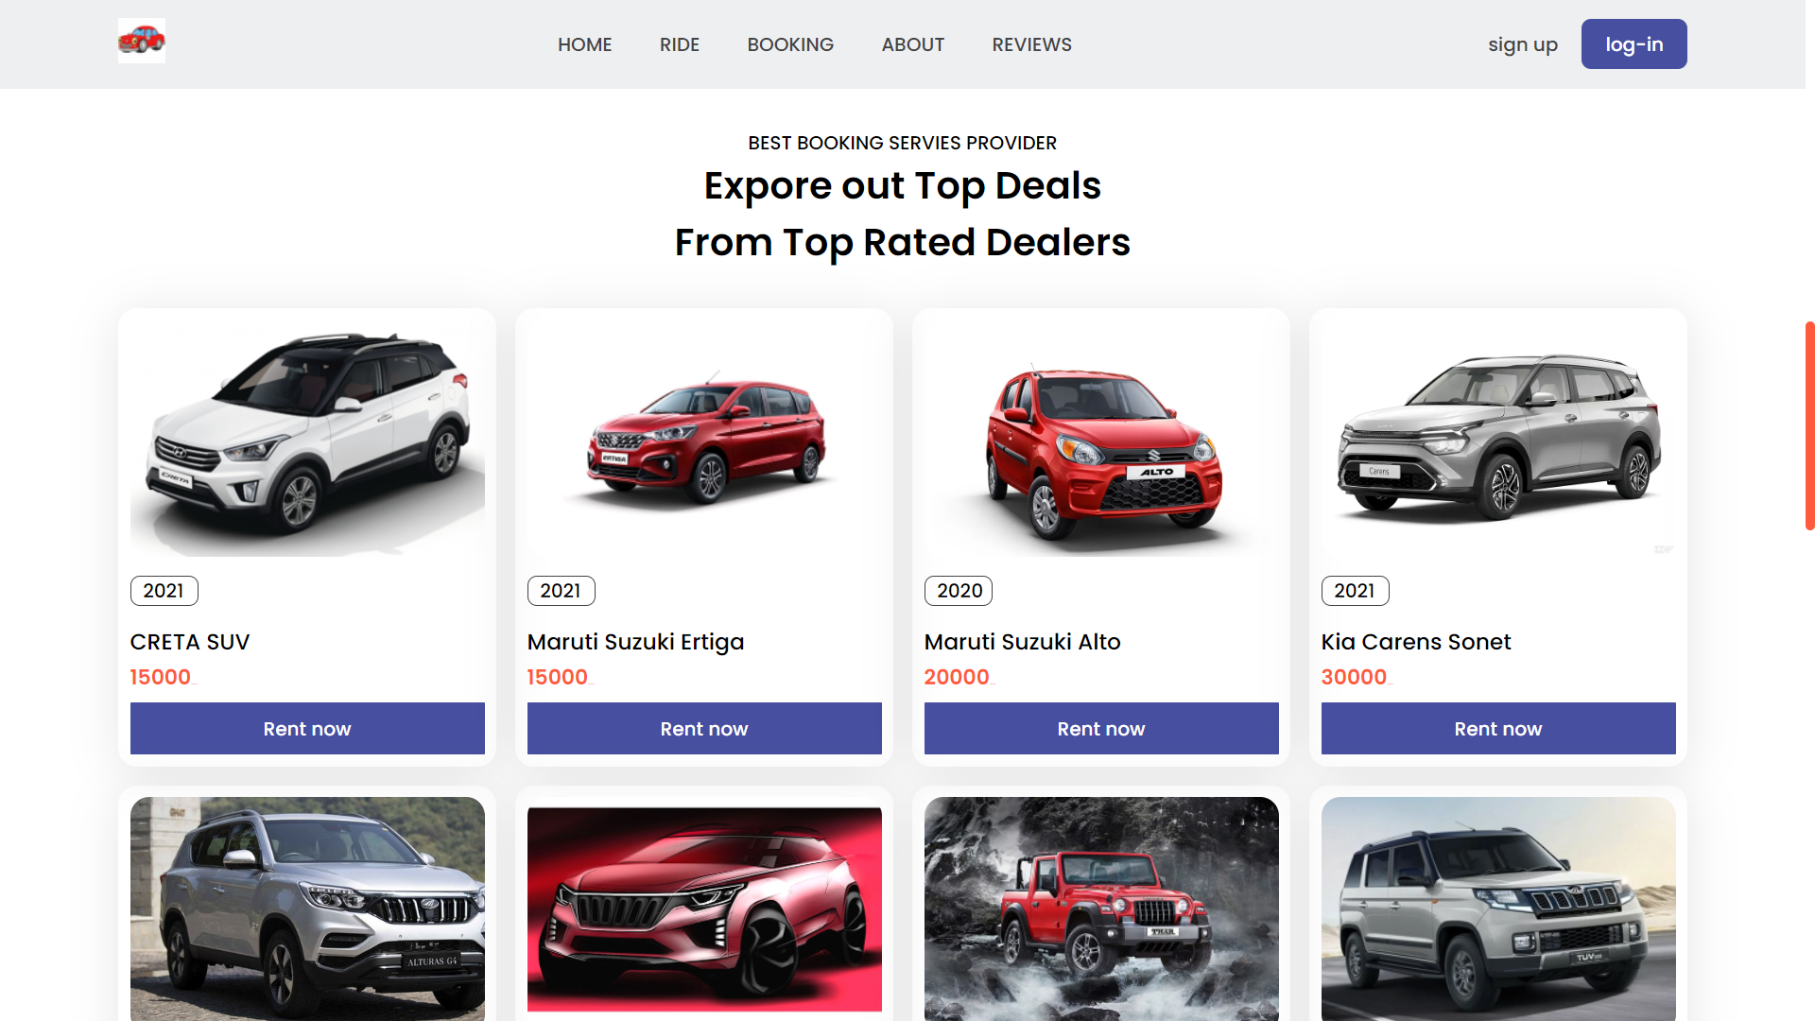

Slide 6
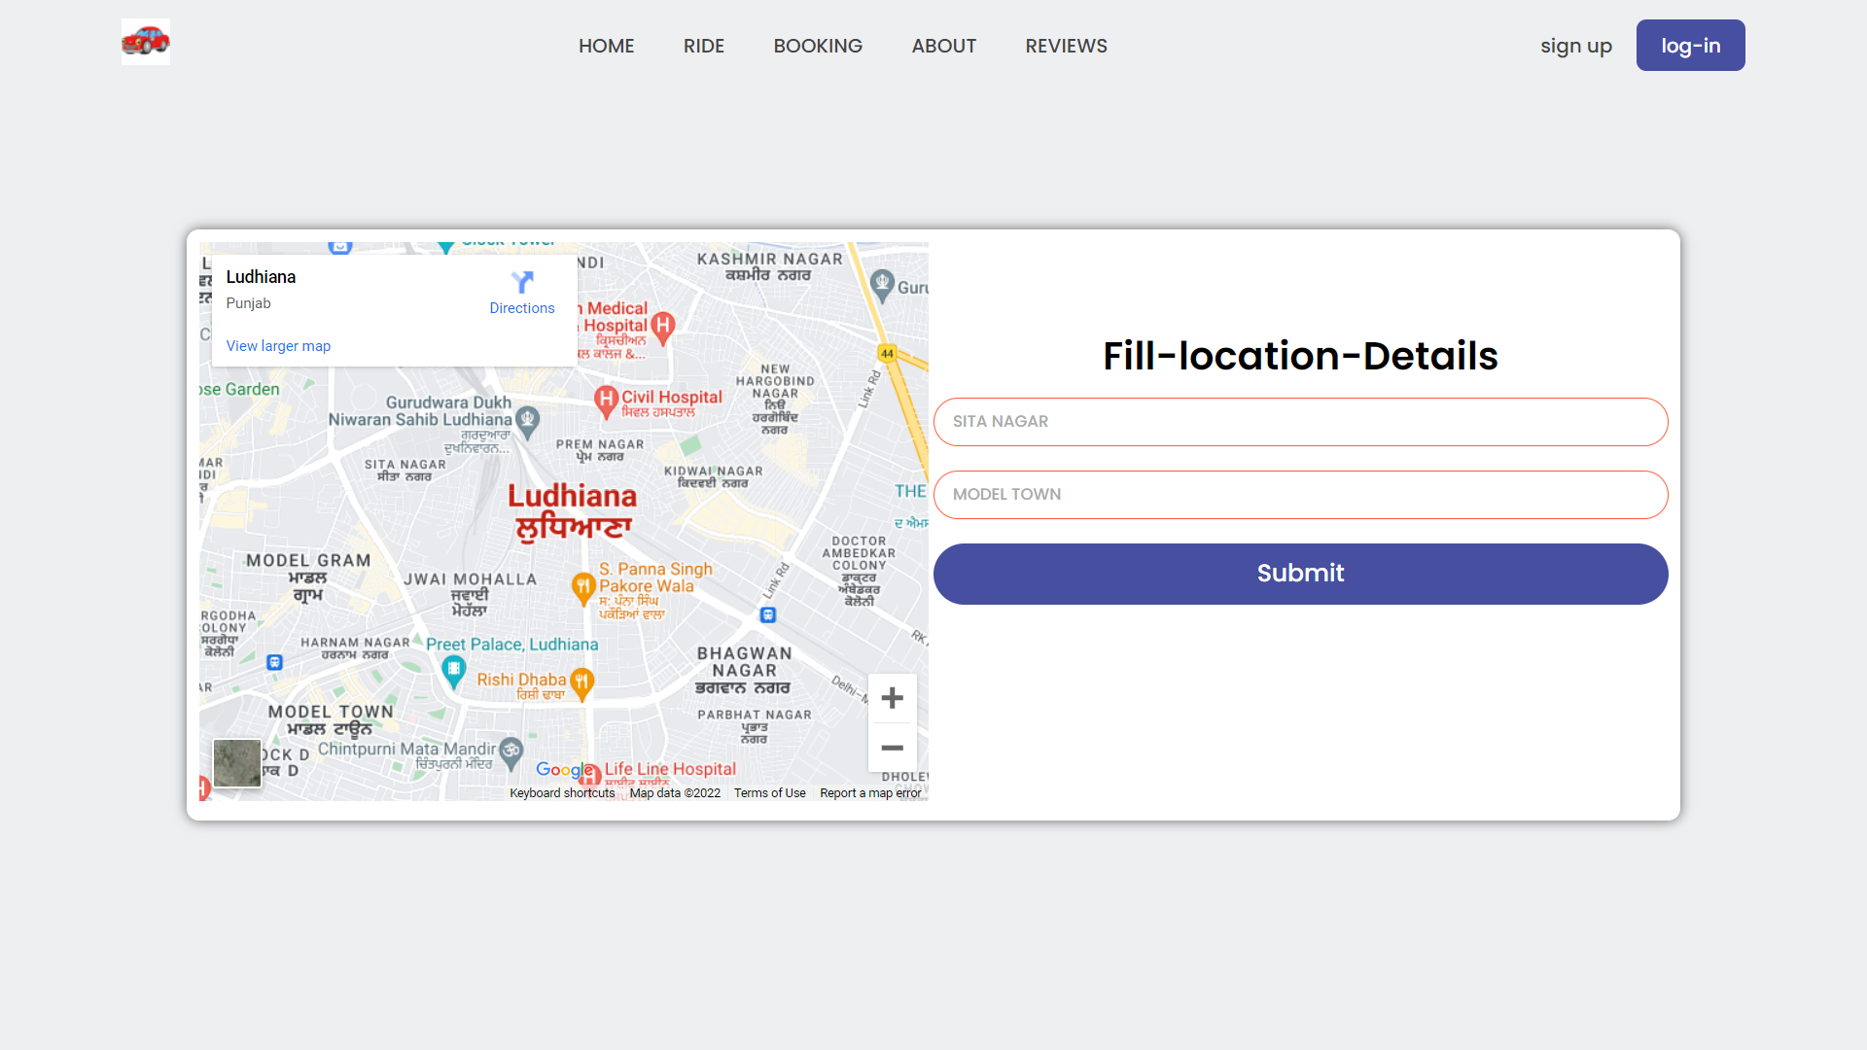

Slide 7
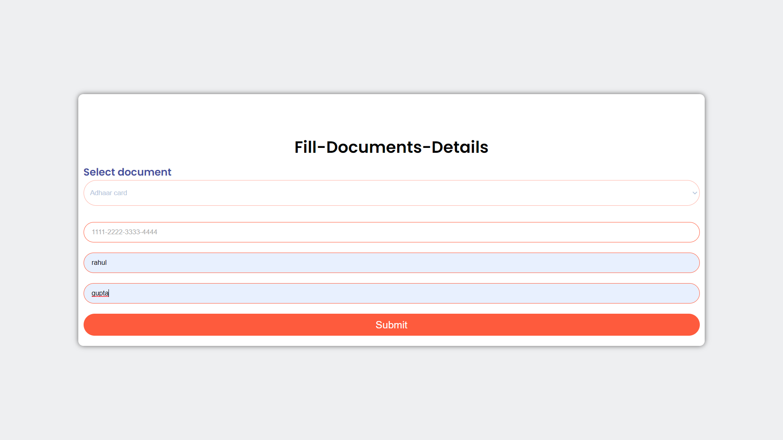

Slide 8
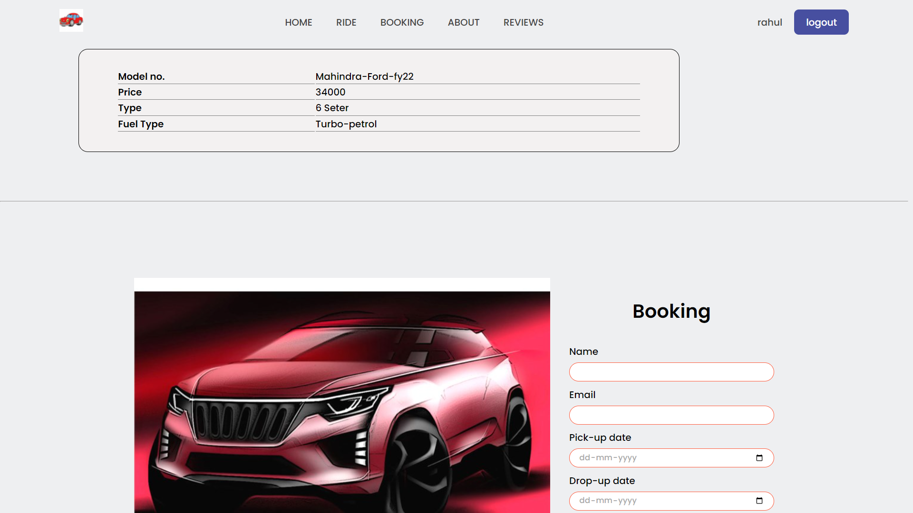

Slide 9
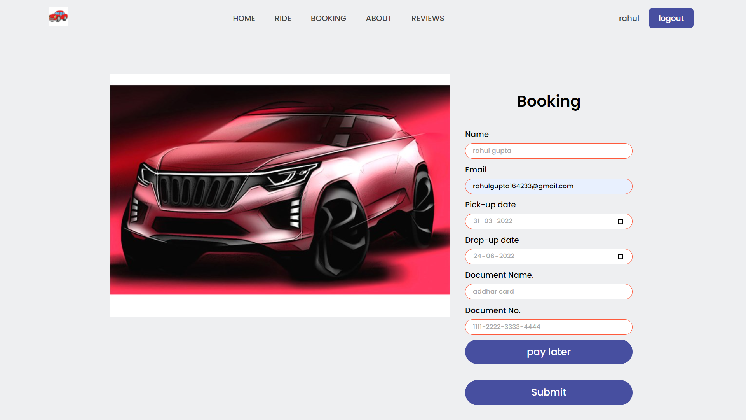

Slide 10
Thank you

